Slide 1
Service Agreement Training

Slide 2
Agenda
Why Change
What are the New Procedures / Forms
How to Choose Which Form to Use
Four New Forms
After the Fact Payment
Reimbursement
Speaker/Artist/ Performer Agreement
Contract for Services

Slide 3
Why Change?
Added protections for the Department and University
Compliance with IRS employee vs Independent Contractor Guidelines
Eliminating After the fact Contracts
Streamlined Reimbursement Process

Slide 4
4 New Forms
After the Fact Payment
Reimbursement For Expenses
Speaker / Artist / Performer Contracts
Contract for Service

Slide 5
When to Use Which Form
After the Fact | Reimbursement | Speaker / Artist / Performer | Contract for Services
Only to be used as a last resort | Used when contractor will only be reimbursed for expenses incurred i.e. travel expenses and will not be issued payment | Used for these three type of services for paying contractors a fee for services and reimbursing any applicable expenses Used for 1 day performances | Used for any other contractor performance i.e. curriculum development, Used when work will take place over multiple days

Slide 6
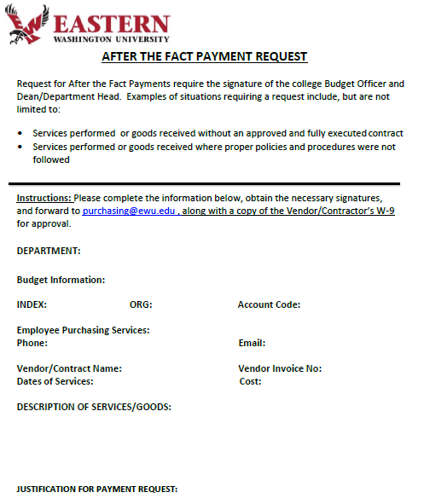
After the Fact Payment
Used only as a last resort
An A W9 and Invoice is still required
Routing
Complete the necessary information
Obtain the necessary signatures
Forward to Purchasing along with the contractor’s W9
Contract will be completed and a copy of the Banner contract emailed to the department with the contract number
Write the contract number on the contractor’s invoice and send the invoice to account’s payable

Slide 7
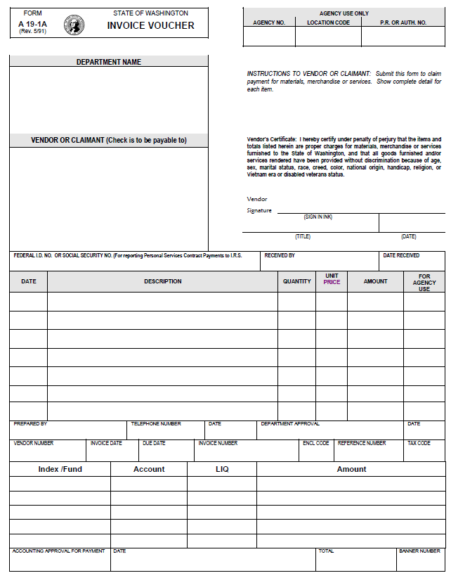
Reimbursement
An A W9 and Invoice is still required
Routing
Complete the necessary information
Obtain the necessary signatures
Forward to Contracts along with the contractor’s W9
Click for instructions on How to fill out the form

Slide 8
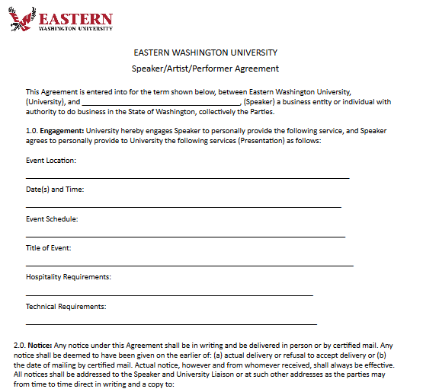
Speaker/ Artist /Performer
An A W9 and Invoice is required
Routing
Complete the necessary information
Obtain the necessary signatures
Forward to Purchasing along with the contractor’s W9
Contract will be completed and a copy of the Banner contract emailed to the department with the contract number
Write the contract number on the contractor’s invoice and send the invoice to account’s payable
Contract’s will send a copy of the completed contract to the contractor
Click for instructions on How to fill out the form

Slide 9
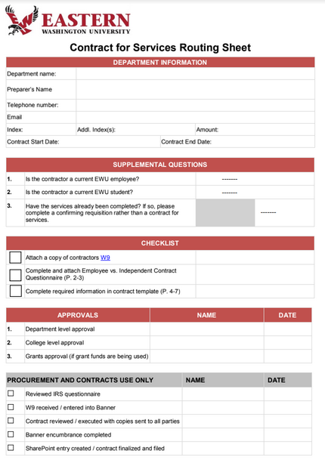
Contract For Service
An A W9 and Invoice is required
Routing
Complete the necessary information
Obtain the necessary signatures
Forward to Purchasing along with the contractor’s W9
Contract will be completed and a copy of the Banner contract emailed to the department with the contract number
Write the contract number on the contractor’s invoice and send the invoice to account’s payable
Contract’s will send a copy of the completed contract to the contractor
Click for instructions on How to fill out the form

Slide 10
Conclustion
Q & A’s

